Slide 1

Biometric data science hrv project
Replicate Intl Michael Coggins, PhD
Current Progress

Slide 2

contents
Purpose
About Me
Current Conclusion
Data Science Life Cycle
Initial Ideation / Problem Definition
Data Acquisition and Exploration
EDA (.csv and .xlsx files); Transformation
Domain understanding and Hypothesis
Outlier analysis and data cleaning concerns
Composite metric development
R&D / Model(s) Building
Using <> to guess at missing age values
Underlying contributors / key feature detection
Using Gen AI to increase adult data
Delivery and Monitoring (not there yet, so…)
Using EKG-based HRV data models to evaluate PPG-based proprietary data

Slide 3



purpose
Why? But….why…(or why not)?
I want to understand us and data can help
For years, I collected biometric data – mostly performance, but some relevant to basic medical health and wellness – as part of my own curiosity regarding client success (or not) as a coach and trainer
In 2016-2019, I created a small pilot study to look at wearable technology as a potentially unbiased data collection/analysis engine to predict improvements in a person’s strength, lean muscle mass, bone density and fat loss based on different exercise and diet interventions
During the pandemic, as gyms closed, I took online courses in Data Science to broaden my analytical techniques as most of what I used in previous research ‘lives’ were basic parametric and non-parametric methods
In 2022, I thought…why not put these together?
But, a professor friend, suggested I use some publicly available data first, as way to have a comparison to other researchers’ data analytics and conclusions.

Slide 4


About me
Entrepreneur (Replicate International) Business Analyst (Credit Suisse, Campbell Alliance) Researcher (Yale, Cornell) Military Engineer (USAF)
Data Scientist (somewhat)
Started computational side projects after career change from equity research to athletic coach / trainer
Started Coursera courses during Covid lockdown (IBM Data Science cert amongst other classes)
LinkedIn

Slide 5
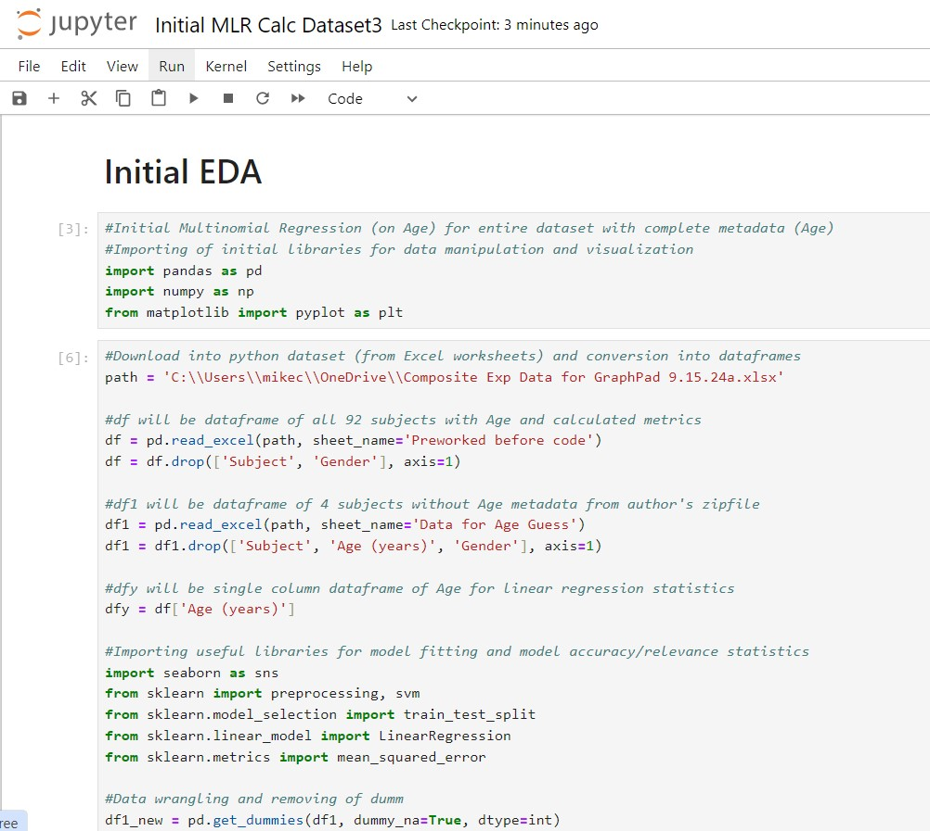
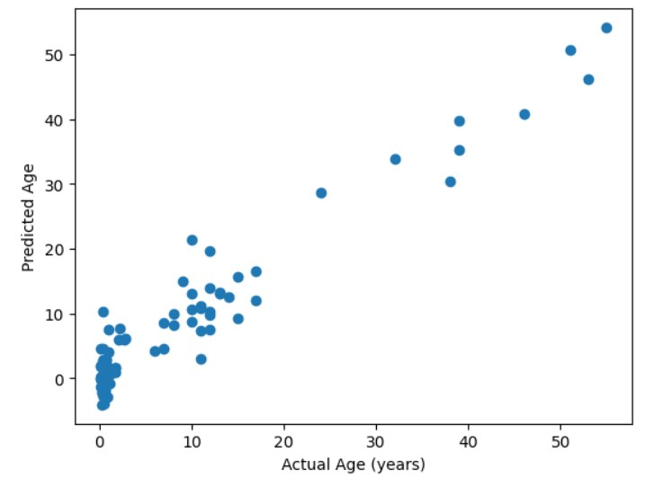
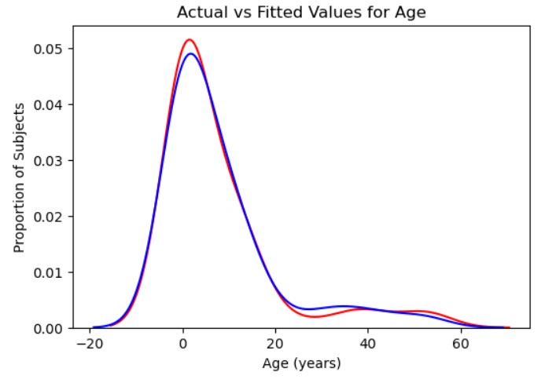
Linear regression current conclusion
Naive linear regression using 32 features of 91 Subjects with full metadata (age) showed IBI/HR not the most predictive features
Initially I chose a supervised multiple linear regression model based on age as the dependent variable:
Initial model will use all 91 subjects and is easy to understand and has significant literature on model benefits and limitations
Full code uploaded to GitHub here:
Relative ranking of most important features (Top 6):
“No Change Count Z[SDNN, 512]”, “No Change Count Z[rMSSD, 512]”/” No Change Count Z[rMSSD]256”, “No Change Count Z[SDNN]256”, “Low Count Z[SDNN]256”, “Low Count Z<2 [SDNN, 512]”, “CoV Avg IBI”
Avg IBI and Avg HR not among Top 6 is somewhat of a surprise given the strong, consistent relationship of infants possessing Avg HRs or ~2x adults

Slide 6

Initial ideation / problem define
Initial idea and first look at a public database

Slide 7
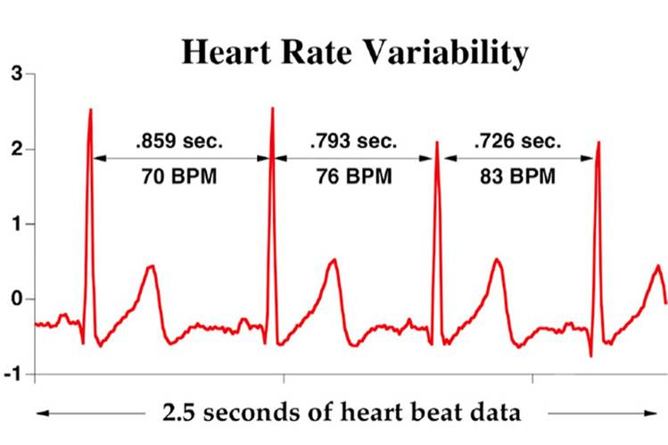
Ideation, problem definition or purpose
Can we learn something new from old data
There exist various publicly-accessible databases of human biometric data with potential for preventative health decisions, or performance-based tailoring of performance/recovery programs
There appears to be untapped potential for data to be analyzed by alternative methods including ML programs
Why not run some of the public data through alternative methods to look for possible uncovered predictors/relevant metrics?
EKG data represent a simple test case with significant years of study (and possibly a number of databases), yet little consensus about predictive value
Can we identify new predictive metrics from EKG data?
This Photo by Unknown Author is licensed under CC BY-NC

Slide 8
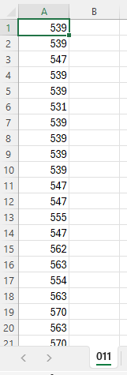
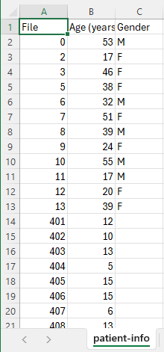
initial data visualization
First, we sought to look at the data to get a feel for the potential for different classes based on age (sex)
Notes:
Inter-Beat Intervals (IBIs, recorded in milliseconds per heart beat) are the reported data. We also converted IBIs to Instantaneous Heart Rates (iHRs, beats/min)
Due to relationship between IBIs and iHRs: iHR = 60 (seconds per min) / IBI (in seconds)
Database included 24-hour Holter monitor recordings of different aged subects:
56 Infants aged (1 month – 3 years 11 months)
11 Adults aged (17 – 53)
24 Adolescents (4 – 15)
4 Unkown
Single Subject IBIs
Metadata

Slide 9
First Database analysis
How data analysis has been done in the past, and our hypothesis

Slide 10
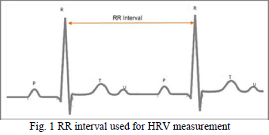
time domain analysis – in the past
Two main measurements:
SDNN – Standard Deviation (from mean over chosen time period)
Evaluates deviations from each beat to the mean
Corresponds to slower time course, lower frequency changes (possibly parasympathetic)
rMSSD – Root Mean Square Standard Deviation (from immediately previous IBI)
Evaluates deviation from immediately previous recorded heart beat
Corresponds to faster time course, higher frequency changes (sympathetic nervous system and respiration, possibly)
Murukesan et al., 2013

Slide 11
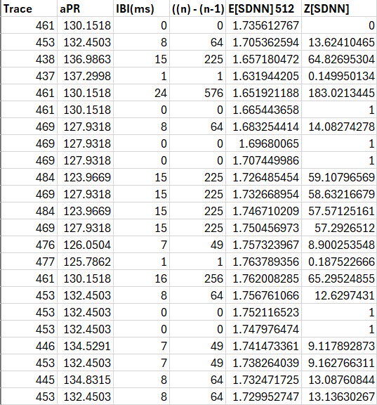
Hypothesis
Versions of normalizing TD data to account for variable expected values given different average HRs
My idea for analysis creates values similar to Z Scores
Z = (x - µ) / σ as a new version of a ‘normalized’ comparator given a pre-existing IBI (or HR)
I chose to use a simple version of an ‘expected noise’ or ‘expected jitter’ appropriate for SDNN (around the time period mean IBI) and rMSSD (immediately previous IBI)
Shown is a single subject with created Z scores (for SDNN comparison metric)

Slide 12
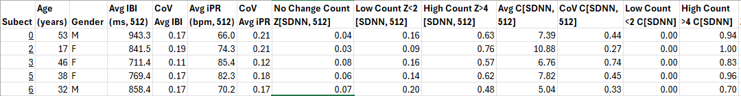
Created composite data
Given different size datasets (row length) and disparities in known attributes, what might better represent individual data
Created a sliding windows of time periods (now many HRV ‘epochs’)
I chose two time periods of 512 IBIs (513 heart beats) and 256 IBIs (257 IBIs)
Given infants have ~2x as many heart beats per time period, this allows for a comparison of similar #IBIs or similar periods of time
512 IBIs is ~6-10 minutes for adults, ~3.5-5 minutes for infants
Now there are thousands of short time epochs (short windows) to potentially better capture periods of stabilized physiological state
T=0, IBI 1
T=x1,
IBI 2
T=x2,
IBI 3
T=x3,
IBI 4
T=x4,
IBI 5

Slide 13
Created composite data
Given different size datasets (row length) and disparities in known attributes, what might better represent individual data
Created a group of simple statistical data as comparators
Sample descriptors such as mean, coefficient of variation, count, etc. help minimize ectopic and missing beats
Some metrics not shown below

Slide 14
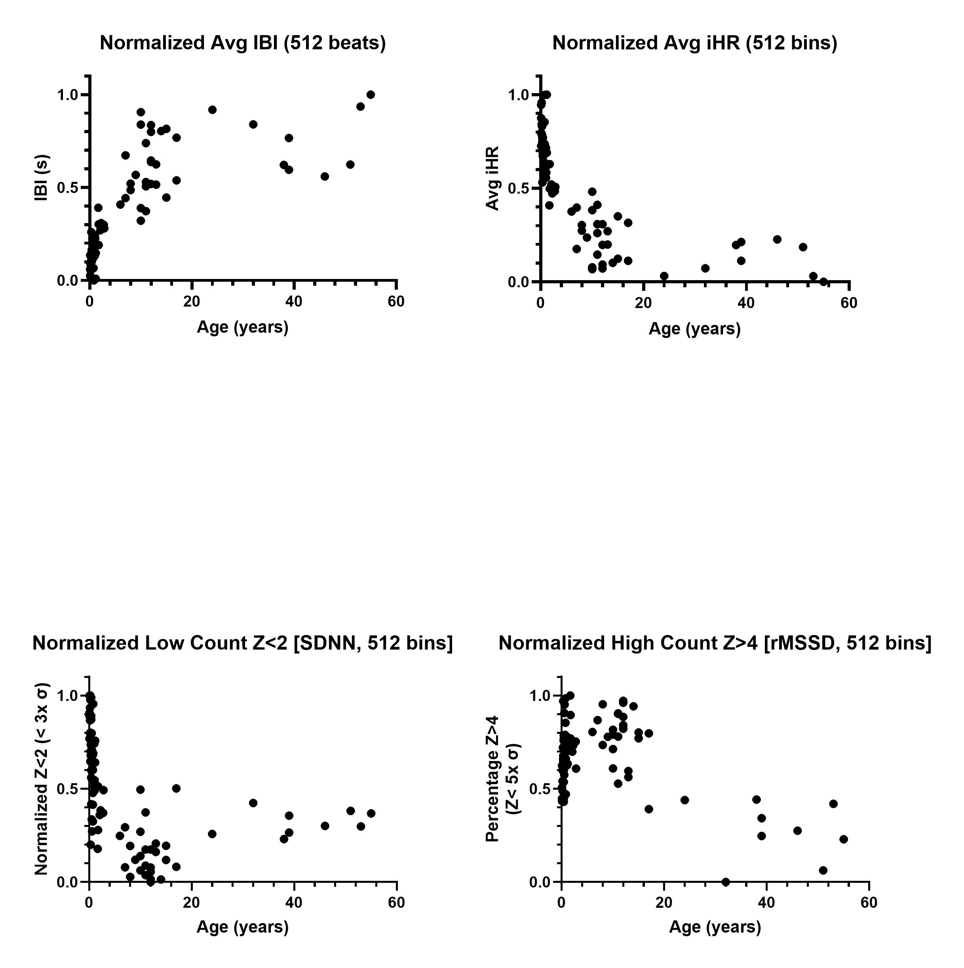
Time domain composite data visualization
Do any of the composite metrics show variation by age or possible 2-3 groupings (infant, adolescent, adult)
Created metric data presented (used for AI/ML processing)
Non-normalized data showed a number of expected trends (and are also visible after normalization)
Infants have significantly smaller IBIs / higher iHRs: top row
Normalized data showed potential for some metrics to group ages into 2 or 3 groups by our created ‘expectation’ Z metric
Low Count represents the percentage of time bin windows that had IBIs < X (initially we chose X to be 2 representing a change of < 3 standard deviations)
High Count represents the percentage of time bin windows that had IBIs > X (initially we chose X to be 4 representing a change of > 5 standard deviations)

Slide 15
Linear regression current conclusion
Naive linear regression using 32 features of 91 Subjects with full metadata (age) showed IBI/HR not the most predictive features
Relative ranking of most important features (Top 6):
“No Change Count Z[SDNN, 512]”, “No Change Count Z[rMSSD, 512]”/” No Change Count Z[rMSSD]256”, “No Change Count Z[SDNN]256”, “Low Count Z[SDNN]256”, “Low Count Z<2 [SDNN, 512]”, “CoV Avg IBI”
Avg IBI and Avg HR not among Top 6 is somewhat of a surprise given the strong, consistent relationship of infants possessing Avg HRs or ~2x adults
Next steps:
Testing model on PPG-derived data to discern a) model features predictive of age, b) model value at all given different technology
Gen AI creation of larger sample of adolescent and/or adult data
Possibly repeat PPG-based assessments post-data generation
Second online database analysis and integration if applicable

